Slide 1





OFSAAI
Data Integrator Framework

Slide 2
Agenda
ETL Architecture
OFSAAI ETL Process
Overview of Data Integrator Framework
DI usage in Basel App (RRF)
Overview of Data Quality Checks

Slide 3
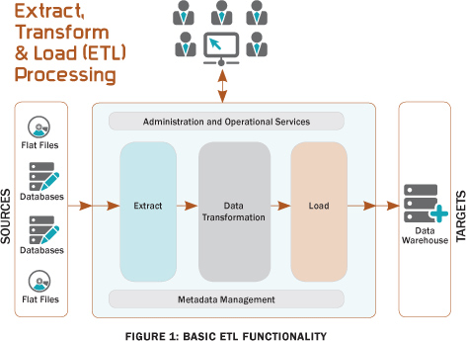
ETL Architecture
Star schema?
What is ETL?
Extraction,
Transformation
Loading
Transformation
Loading
Database tables or Flat files
Extraction
(staging)
SQL Loader

Slide 4
OFSAAI ETL Process
Data manipulation(transformation)
Dim / fact table and other sources
Data sources
T2F
T2T/F2T

Slide 5
DI Framework
Components of DI
Warehouse Designer:
Facilitates to define and create Data Source Models
The Warehouse Designer consists of the following sections:
Data Sources→ generate data models
Database Extracts → retrieving unstructured data from data sources it can be for table or file
File Extracts→ extract Flat File data to a Database Table
Warehouse designer
Post load transformation
Data quality framework
SQL rules

Slide 6
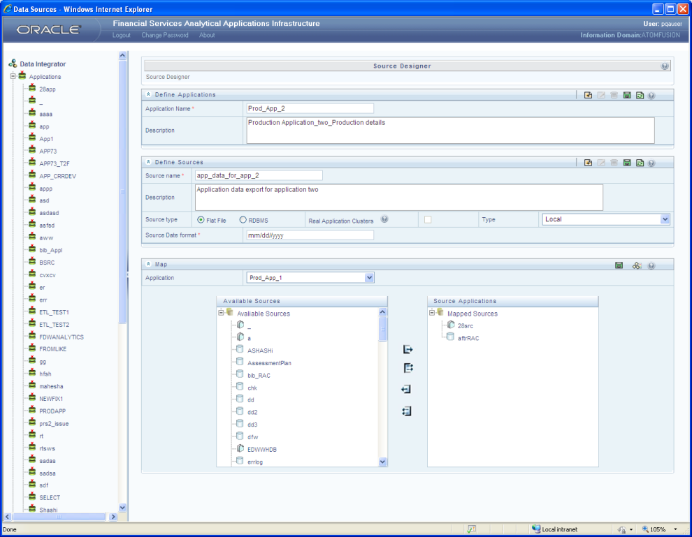
Data Sources Designer
consists of
Data Source Application→ logical group of Data Sources
Data Sources→ the physical structure or location of the source file
Mapping Data Sources to Applications→ Grouping of source to multiple applications

Slide 7
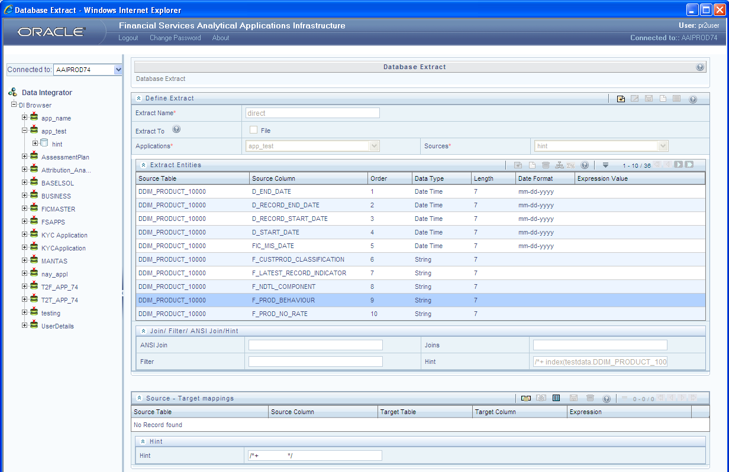
DB extract
defined as a subset of the source model which can have one or more source entities

Slide 8
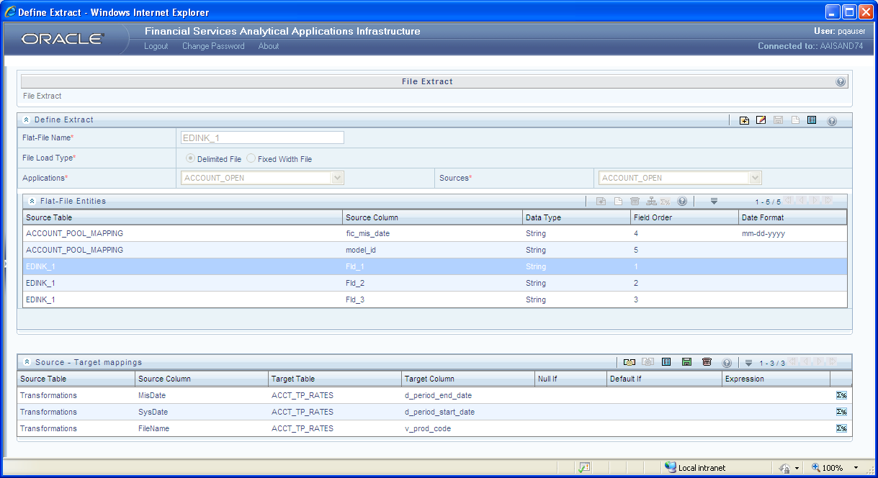
File Extract
the process of extracting unstructured data from a Flat File for further data processing and storage
Can be of two types
Delimited File refers to a Flat File in which the data is organized in rows and columns and are separated by delimiters
Fixed Width or Fixed Position File refers to a Flat File in which the data is defined by the character position

Slide 9
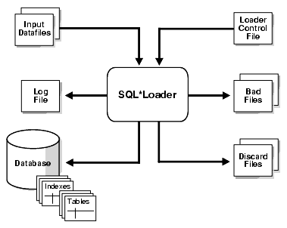
Data Integrator
SQL*Loader
--A typical SQL*Loader session takes as input a control file, which controls the behavior of SQL*Loader, and one or more datafiles. The output of SQL*Loader is an Oracle database (where the data is loaded), a log file, a bad file, and potentially, a discard file.
SQLLDR CONTROL=sample.ctl, LOG=sample.log, BAD=baz.bad, DATA=etc.dat USERID=scott/tiger, ERRORS=999, LOAD=2000, DISCARD=toss.dsc, DISCARDMAX=5

Slide 10
Sample Control File
OPTIONS (
DIRECT = FALSE)
LOAD DATA
INFILE '#INFILE' "str '\n'"
BADFILE '#BADFILE'
DISCARDFILE '#DISCARDFILE'
INTO TABLE DIM_INDEX
APPEND
(
n_index_skey POSITION(1:5) DECIMAL EXTERNAL,
v_index_code POSITION(6:11) CHAR(6),
v_index_desc POSITION(12:71) CHAR(60)
)
--END OF TABLE

Slide 11
DI Contd…
DI usage in other modules
RRF→ Run Objects will hold the DI Objects for further Data Transformations and Data Load.
Model upload→ Before model upload it checks the existing entry in rev_tl_mapping table.

Slide 12
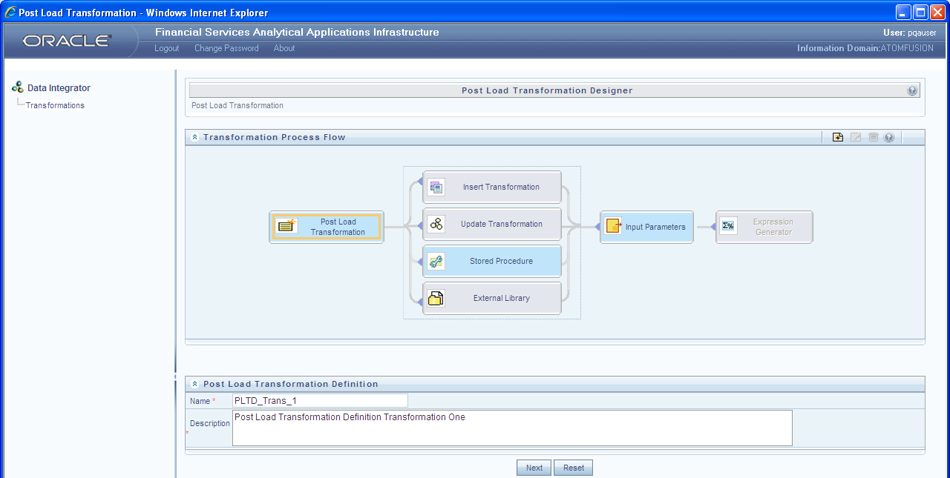
Post load Transormation
refers to a rule describing the conversion of source data from source to the destination

Slide 13
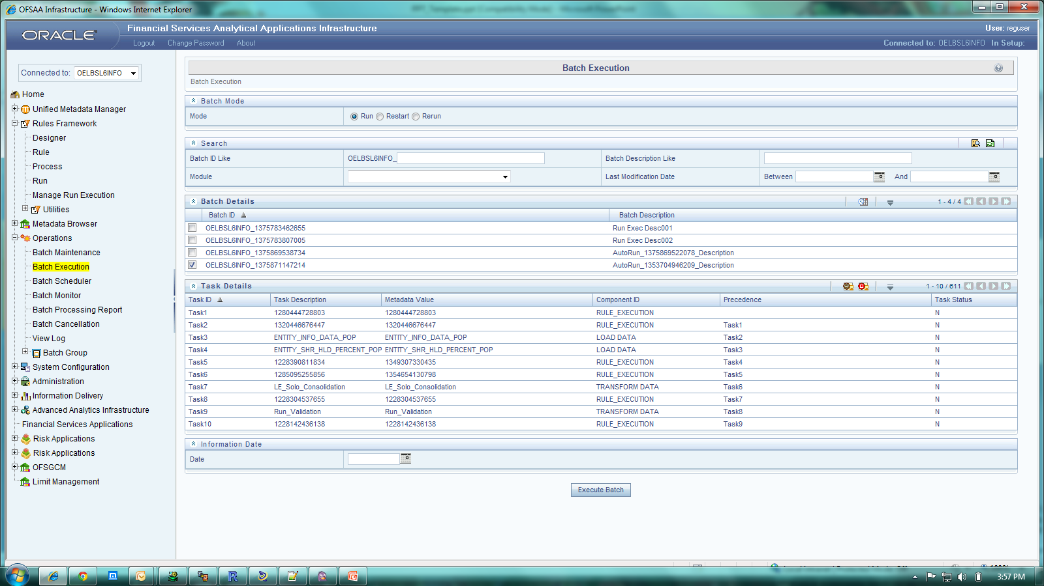
RRF: Data Loading and Data Transformations

Slide 14
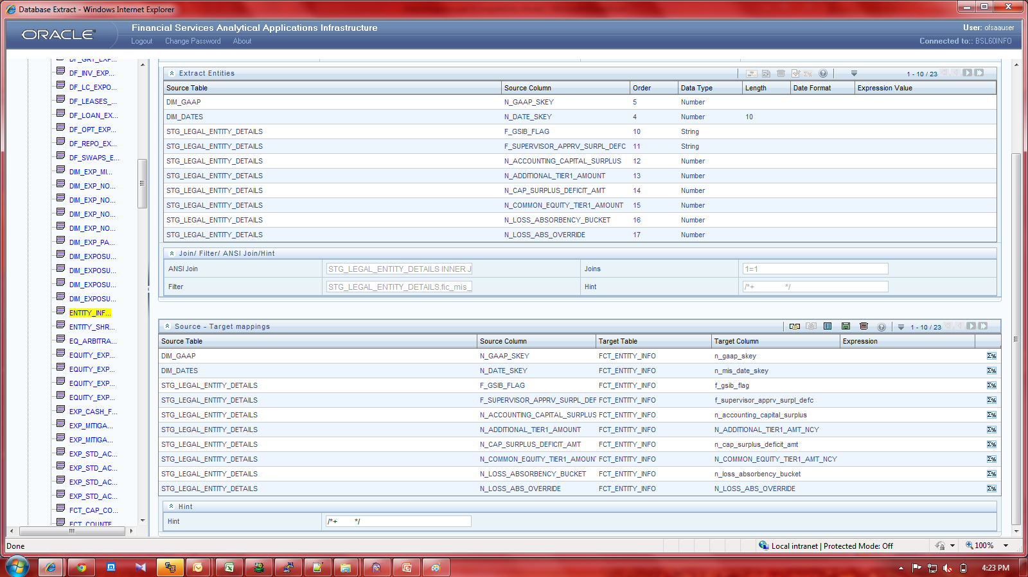
Table Load

Slide 15
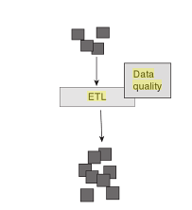
Data Quality
Data are of high quality "if they are fit for their intended uses in operations, decision making and planning”
As data passes through the ETL process , there is an opportunity to do some basic data quality examination and even editing . Because source data must pass through the ETL processing in any case on its way to the data ware house .
Below are the common DQ Checks performed
1. Range check
2. Null Check
3. Data length Check
4. Blank check
5. Duplicate check

Slide 16
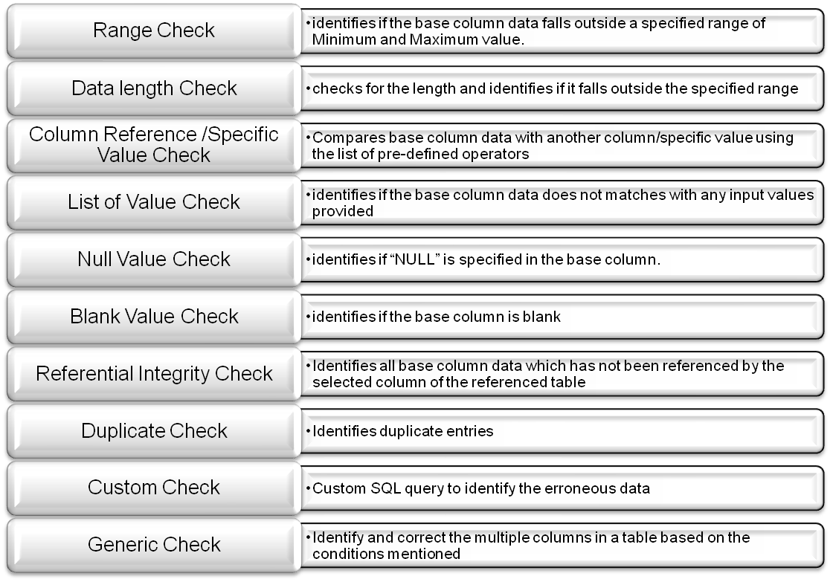
OFSAAI DQ Framework
OFSAAI DQ Framework enables user to defined below DQ Checks

Slide 17
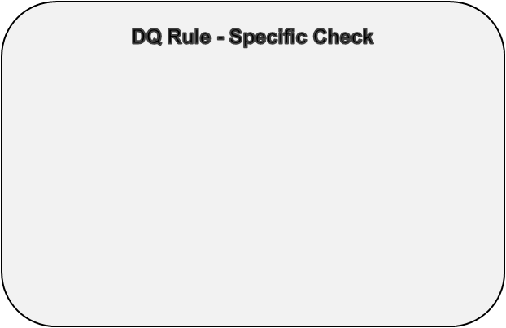












OFSAAI Data Quality Framework Contd…
DQ Group
Before DB Check
After DB Check

